Slide 1
Module 6 – Data Operations Day 4
Presented by
Group A: Jonathan C., Michael, Craig, Jo
https://github.com/DASHEYJ3/Module_6_ETL_GroupA.git

Slide 2
Introduction
Plan, build and present an ETL Pipeline, end to end.
Sprint 1 = Planning
Sprint 2 = Execution/BUILD
Sprint 3 = Presentation/Demo

Slide 3
KANBAN BOARD
To Do​ | In Progress​ | Done​
Identify API/sources |  | Reviewed Jupyter Notebook and identified improvements
Agree Monitoring Strategy/Incident Response |  | Data Flow Diagram
 |  | ETL and Retry using Python
 |  | High Level Data Engineering Dashboard - scoping
 |  | GitHub Repo

Slide 4
Sprint 1 - PLANNING
Reviewed the scripts
Reviewed the skill base of the Team
Agree on tasks and roles
MSCW
Must Have: meaningful logs, visibility
Must Have: response to failures/alerting
Must Have: Quality and Governance
Must Have: persisted database/reusable code
Should Have: pull data from API/sources (no hard-coded logic where a data source exists)
Should Have: Power BI Dashboard
Could Have: GitHub repo
Could Have: Kanban Board
Notes:
Example objectives
At the end of this lesson, you will be able to:
Save files to the team Web server.
Move files to different locations on the team Web server.
Share files on the team Web server.

Slide 5
User Stories – Sprint 1
Instructions & Overview - Module 6 - Data Operations
As a Data Engineer, I want to design a monitoring dashboard so that stakeholders can see pipeline health at a glance.
As a Data Engineer, I want to visualise our ETL data flow so that team members understand the pipeline structure.
As a Data Engineer, I want to assess what's missing for production deployment so that we can prioritise improvements.
As a Data Engineer, I want structured logging in our ETL pipeline so that I can track execution progress and identify issues.
As a Data Engineer, I want a clear incident response process so that I can quickly resolve pipeline failures.
As a Data Engineering Team Lead, I want a clear error classification system so that incidents are escalated appropriately.
As a Data Engineer, I want automatic retry functionality for transient failures so that temporary issues don't cause complete pipeline failures.
As a Data Engineer, I want to test failure scenarios so that I can validate our recovery procedures.
As a Data Operations Manager, I want a comprehensive disaster recovery plan so that we can restore operations quickly after major failures.

Slide 6
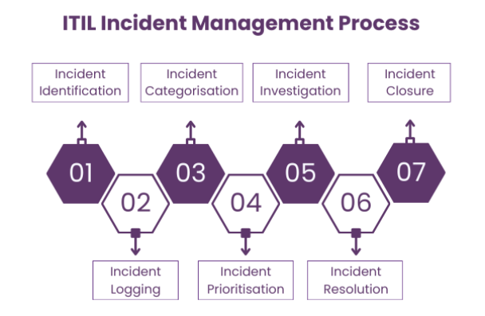
Monitoring Strategy and Incident Response
As a Data Operations Manager, I want a comprehensive monitoring strategy so that our team can effectively observe pipeline health.
As a Data Operations Manager, I want a comprehensive logging strategy so that our team can effectively troubleshoot pipeline issues.
As a Data Engineering Team Lead, I want to understand current monitoring gaps so that I can prioritise observability improvements.
As a Data Operations Team, I want email notifications for critical pipeline failures so that we can respond quickly to issues.
As a Data Engineer, I want structured logging in our ETL pipeline so that I can track execution progress and identify issues.
As a Data Engineer, I want to monitor database connectivity so that I can detect connection issues before they cause pipeline failures.
As a Data Engineer, I want a clear incident response process so that I can quickly resolve pipeline failures.
Power BI Dashboard and on-screen alerting in Data Ops
Incident Strategy – agree P1, P2 response times with Data Engineering Team as a resolving team.
Email Alerting to central Data Operations inbox/Teams Channel.
Comms Strategy – agree comms templates to Stakeholders when there are outages, both Planned and Unplanned.
Root Cause Analysis and Problem strategy

Slide 7
Governance Framework
Governance is something which is very important and ensuring that customers can trust us with their data is essential in these times with increasing cyber attacks and the importance of data in general.
Approach
Create a Data Governance Framework which sets sensitivity at a table and column level which is hierarchical.
Each project has the following groups created:
Public – Data can be seen by anyone with access
Internal – some degree of sensitivity address , usernames etc
Sensitive – telephone numbers bank account details etc
If no table level is set then it is by default Public
Downstream tables inherit the permissions of their parent.
Users are then given access to the group for what they can see. Not even data Engineers are given sensitive if not needed,

Slide 8
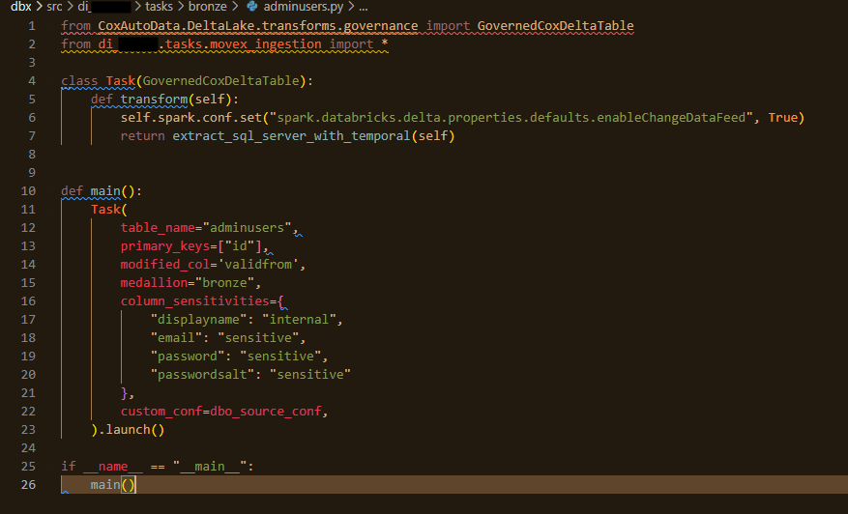
Implementation
This is done in Bronze
Fields are dropped out in Silver if not needed

Slide 9
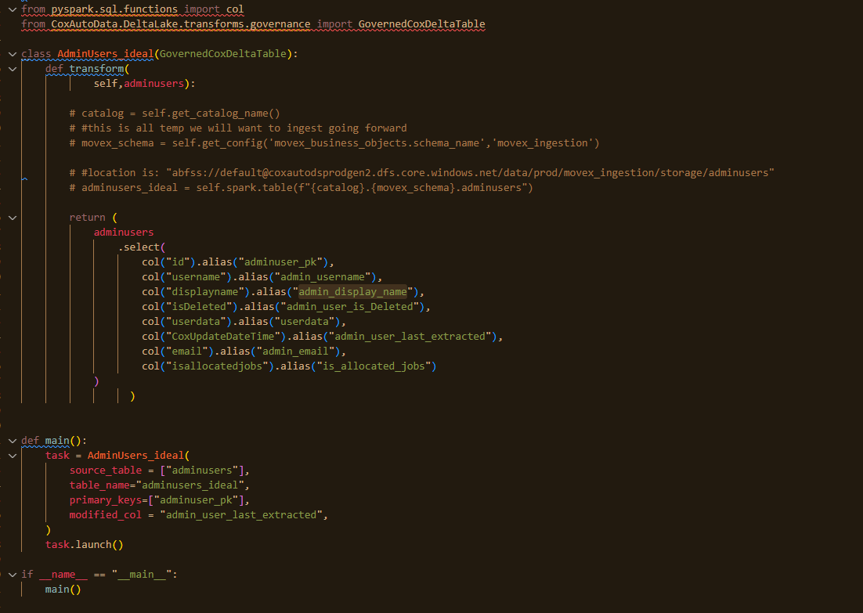
Implementation

Slide 10
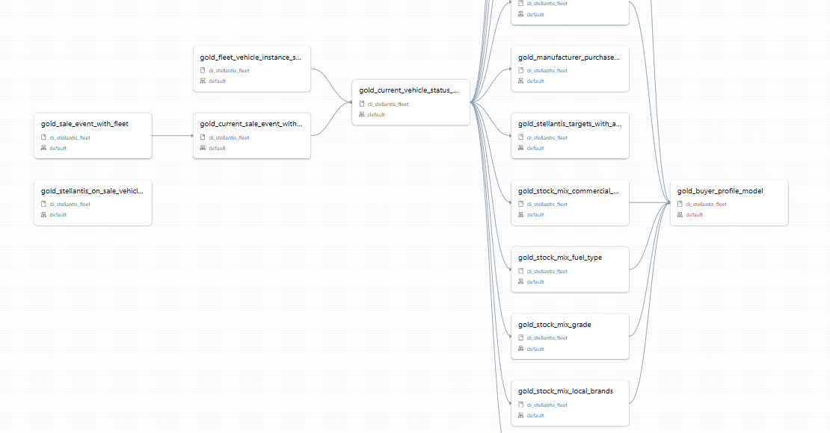
Implementation

Slide 11
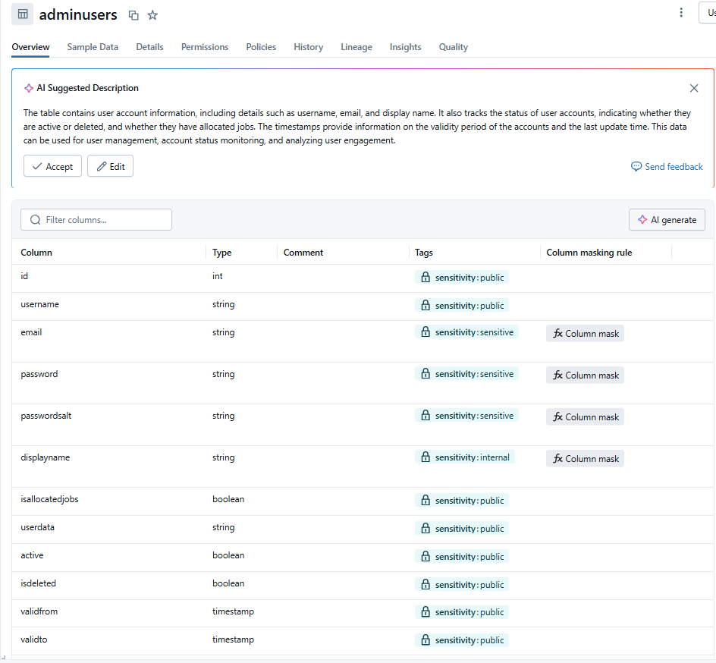
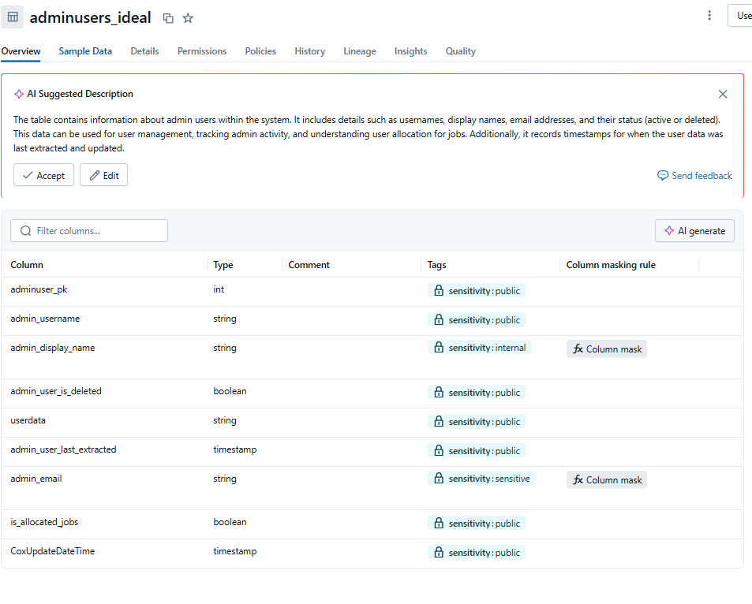
Implementation

Slide 12
Row level Security
Ensuring users can only see what they should is very important , especially when dealing with external user’s reporting. We have solved this in Power BI and Tableau

Slide 13
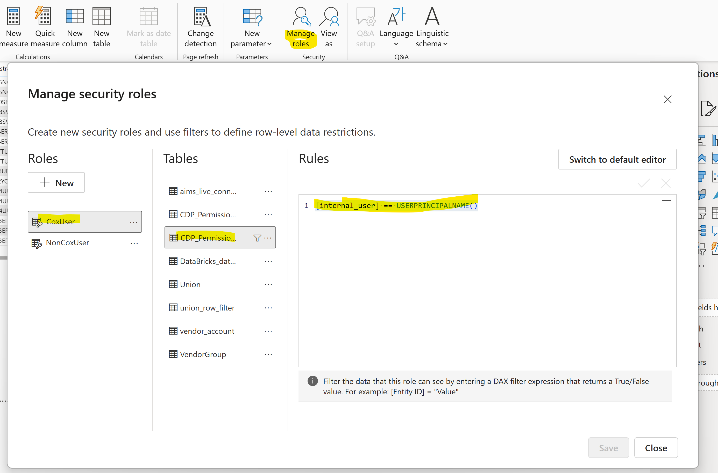
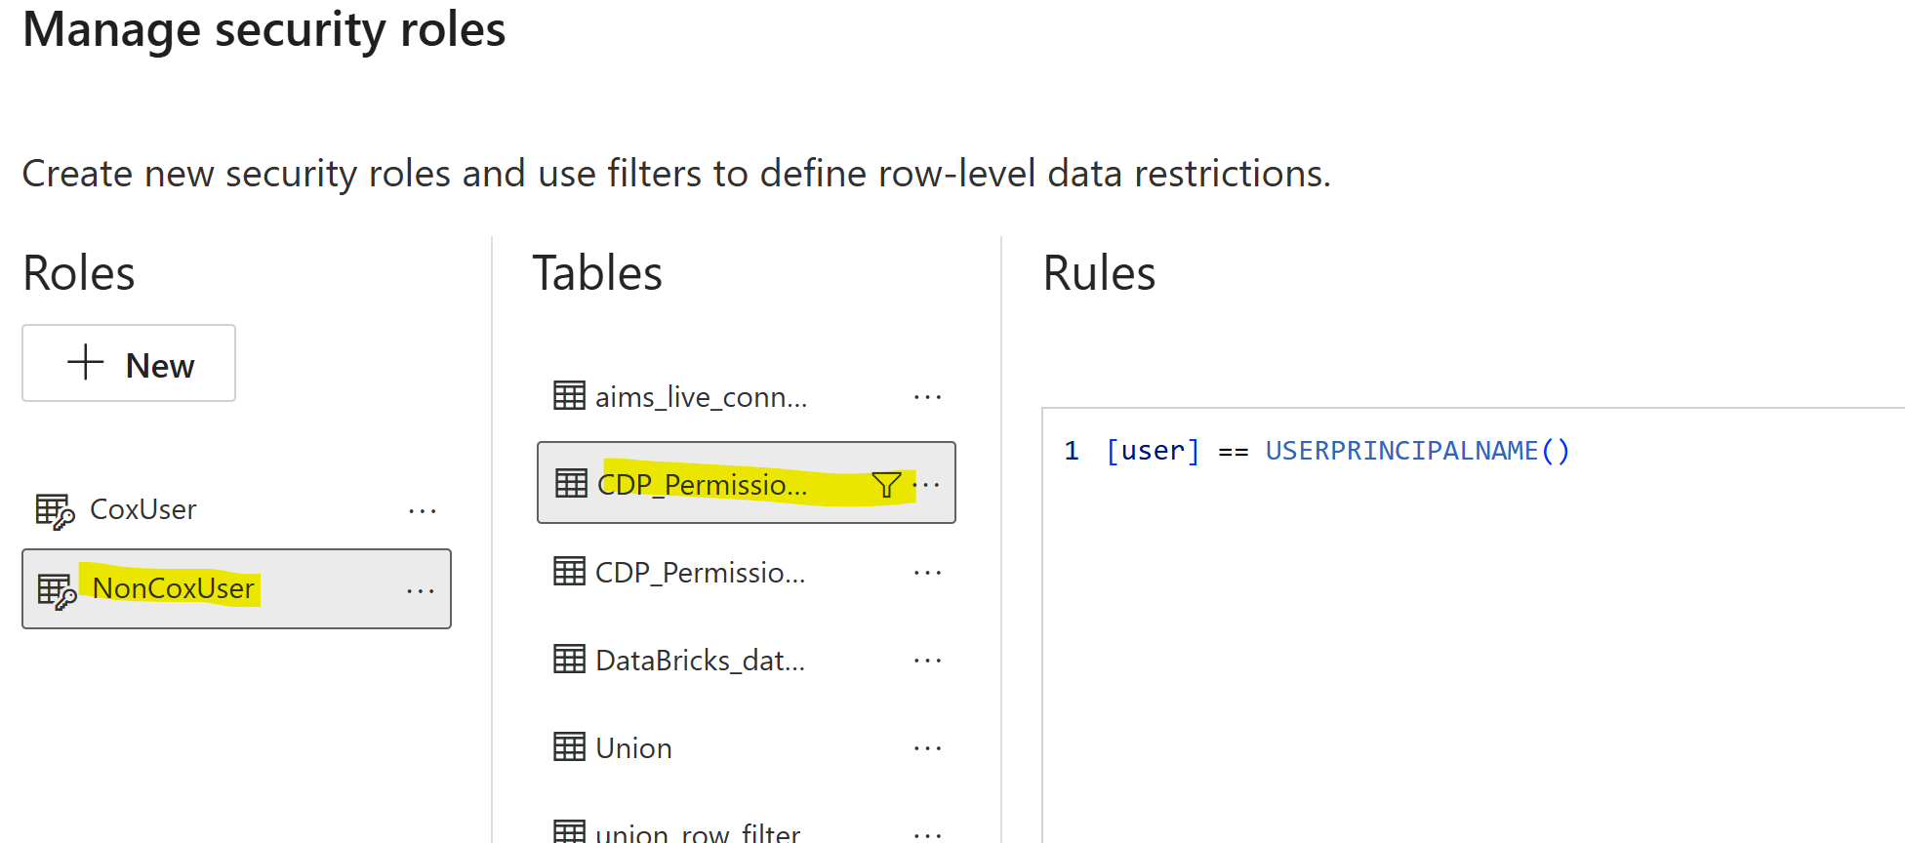
Implementation

Slide 14
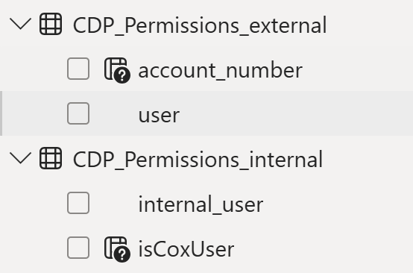
Implementation

Slide 15
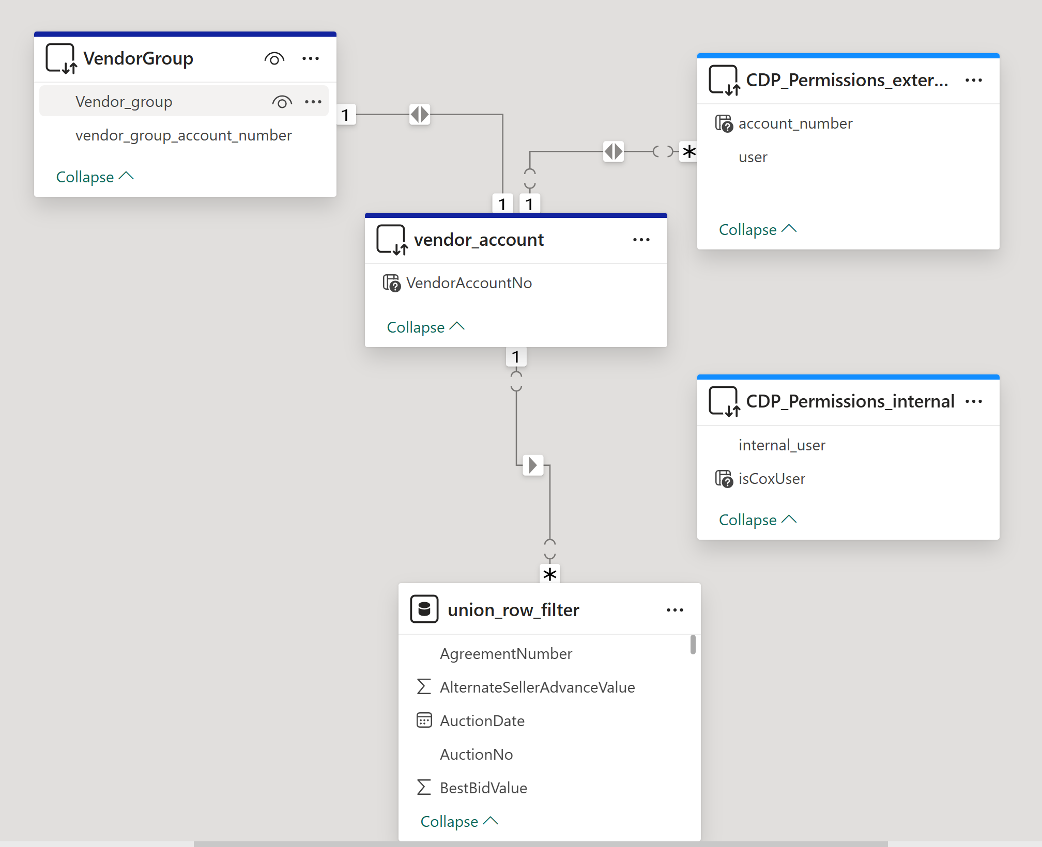
Implementation

Slide 16
Sprint 2 - EXECUTION
As a Data Engineer, I want to visualise the data flow and look for ways to improve it:
Module_6_ETL_GroupA/ETL Project Data Flow.pdf at main · DASHEYJ3/Module_6_ETL_GroupA
Notes:
Example objectives
At the end of this lesson, you will be able to:
Save files to the team Web server.
Move files to different locations on the team Web server.
Share files on the team Web server.

Slide 17
Sprint 2 - EXECUTION
https://github.com/DASHEYJ3/Module_6_ETL_GroupA.git
Python ETL
As a Data Engineer, I want automatic retry functionality for transient failures so that temporary issues don't cause complete pipeline failures.
https://github.com/DASHEYJ3/Module_6_ETL_GroupA.git
Notes:
Example objectives
At the end of this lesson, you will be able to:
Save files to the team Web server.
Move files to different locations on the team Web server.
Share files on the team Web server.

Slide 18
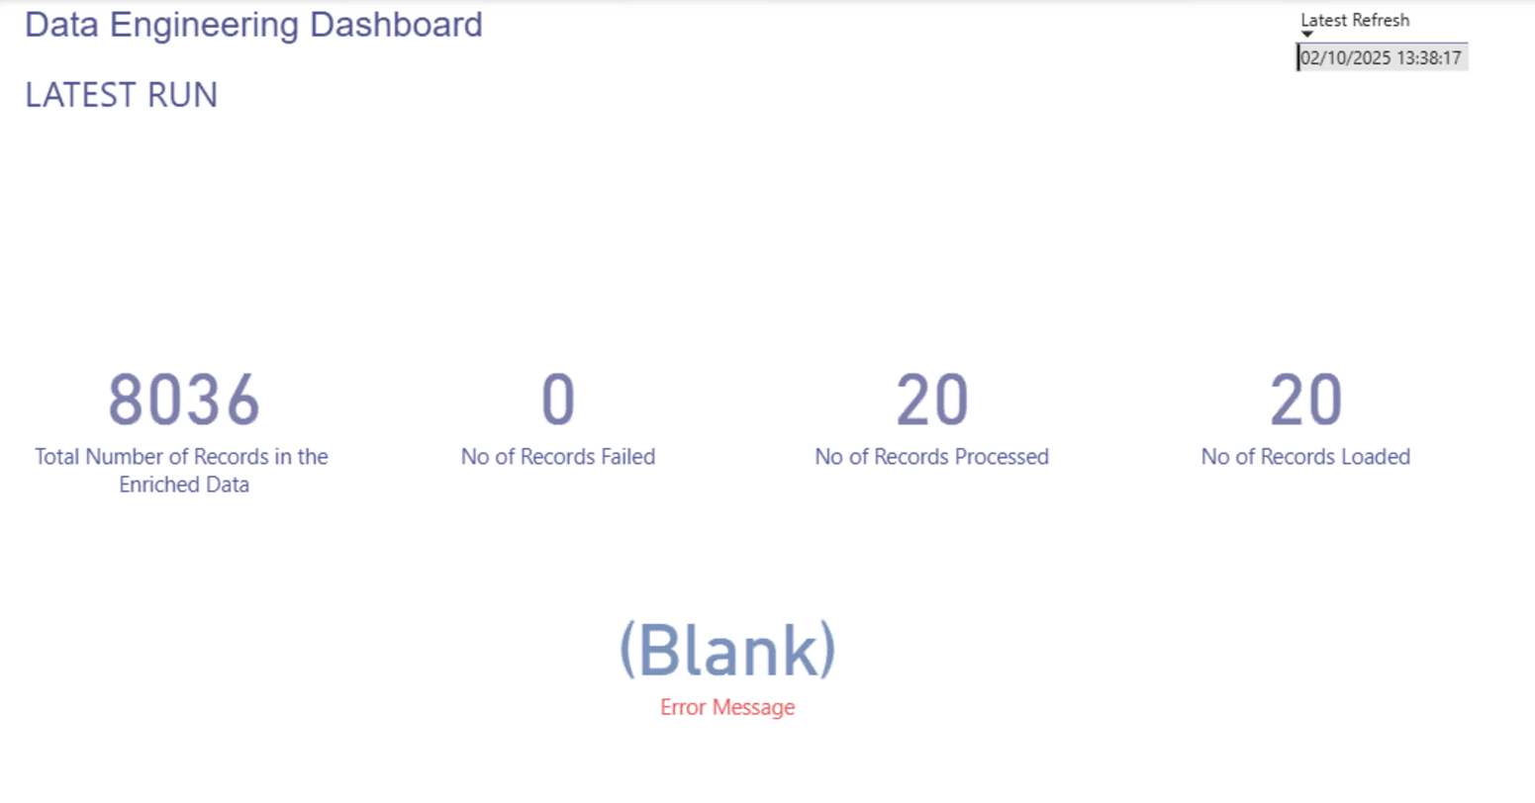
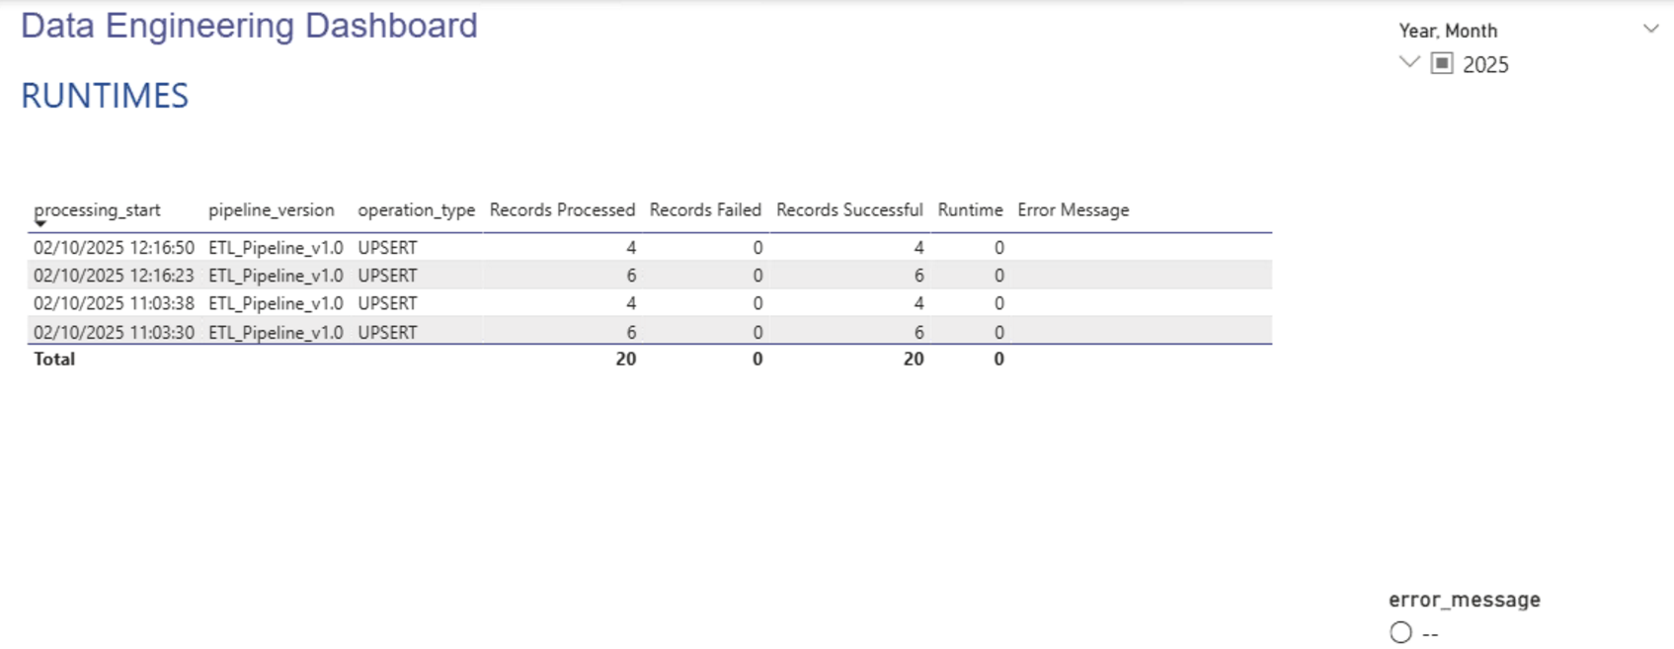
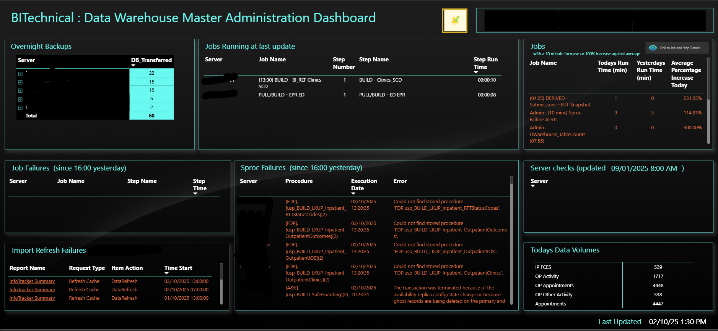
Sprint 2 - EXECUTION
As a Data Engineer, I want to design a monitoring dashboard so that stakeholders can see pipeline health at a glance.
Notes:
Example objectives
At the end of this lesson, you will be able to:
Save files to the team Web server.
Move files to different locations on the team Web server.
Share files on the team Web server.

Slide 19
Wrap-up
Summarise important points.
Allow time for questions.

